Slide 1
Design Modeling: Design Class Diagram
Instructor: Mehroze Khan

Slide 2
Object-Oriented Design Processes and Models
Diagrams developed for analysis/requirements
Use case diagrams and Use case descriptions
Activity diagrams
Domain model class diagrams
System sequence diagrams
Diagrams developed for design
Interaction diagrams and package diagrams
Design class diagrams – include object-oriented classes, navigation between classes, attribute names, method names, and properties needed for programming

Slide 3
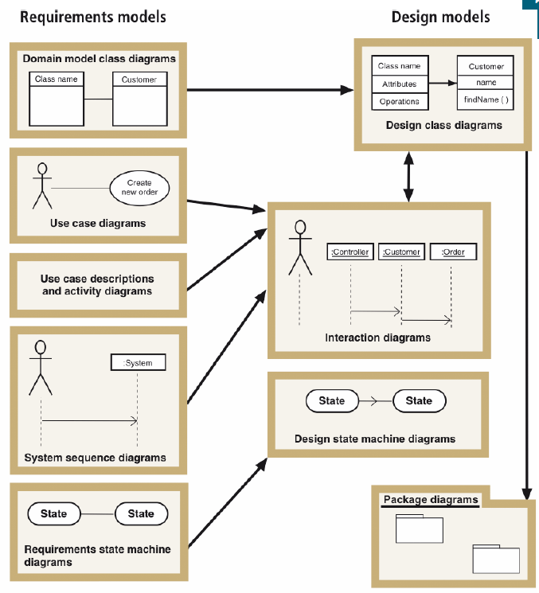
Design Models with Their Respective Input Models

Slide 4
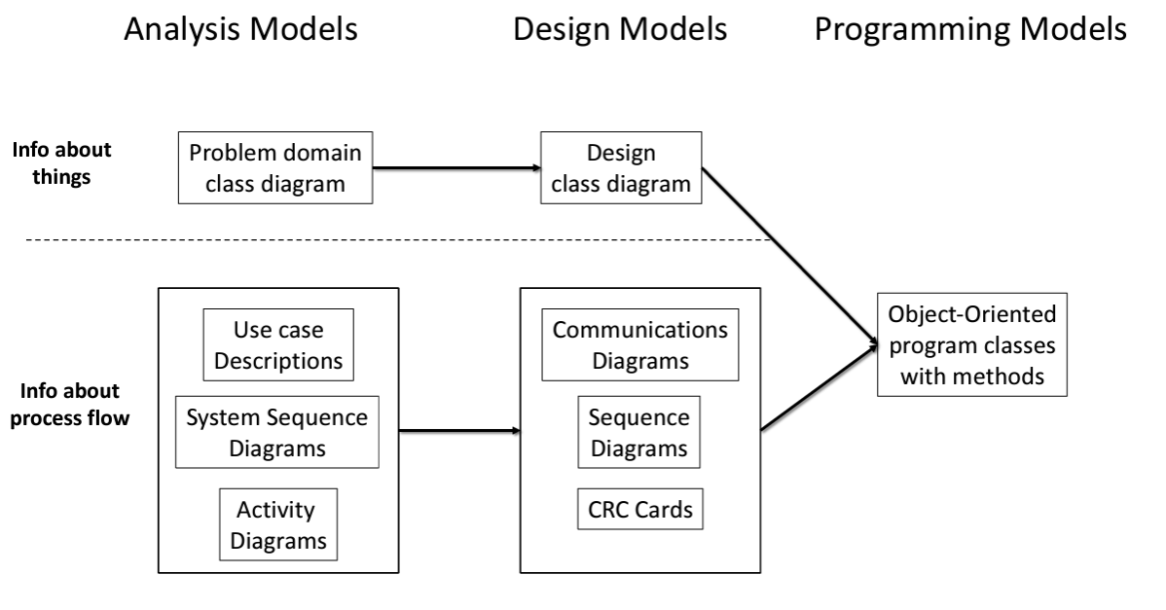

Slide 5
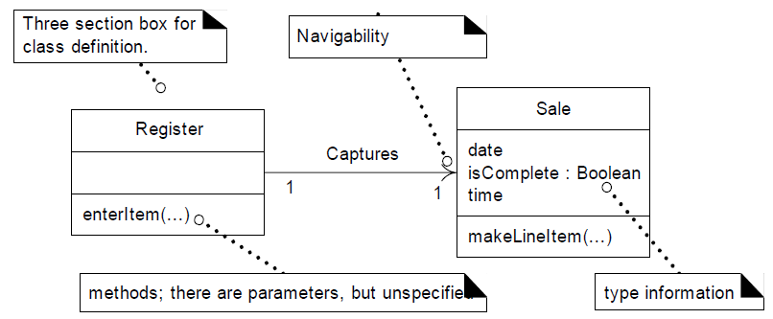
Design Class Diagram
In addition to basic associations and attributes, the diagram is extended to illustrate
Methods of each class
Attribute type information
Attribute visibility
Navigation between objects

Slide 6
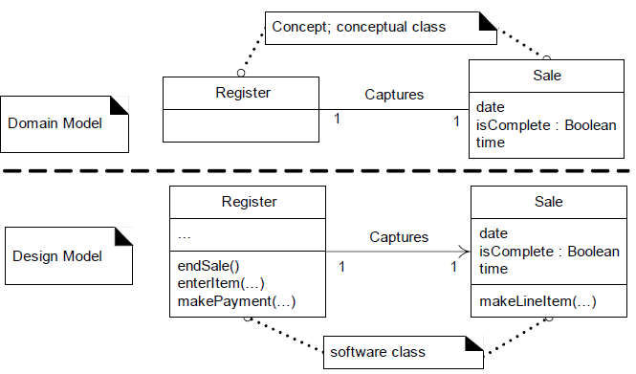
Domain Model Vs Design Model Classes
In Domain Model, a Sale does not represent a software definition; rather, it is an abstraction of a real-world concept about which we are interested in making a statement.
By contrast, DCDs express—for the software application—the definition of classes as software components. In these diagrams, a Sale represents a software class

Slide 7
Creating DCD

Slide 8
Identify Software Classes and Illustrate Them
The first step in the creation of DCDs as part of the solution model is to identify those classes that participate in the software solution.
These can be found by scanning all the interaction diagrams and listing the classes mentioned.
For the POS application, these are some classes:
Register
ProductCatalog
Store Payment
Sale
ProductSpecification
SalesLineItem

Slide 9
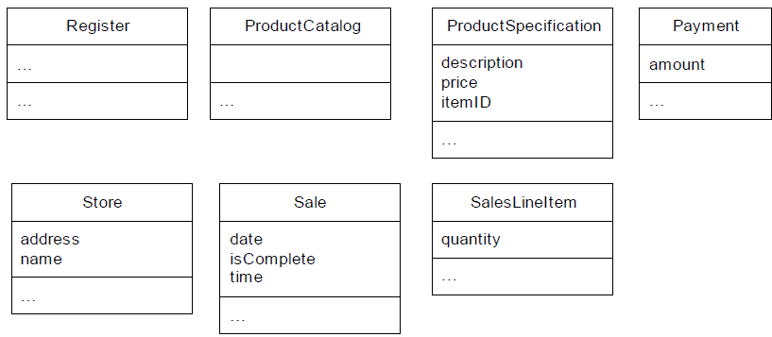
Draw Classes and Add Attributes
The next step is to draw a class diagram for these classes and include the attributes previously identified in the Domain Model that are also used in the design.

Slide 10
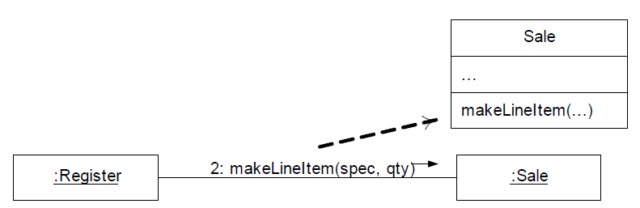
Add Method Names
The methods of each class can be identified by analyzing the interaction diagrams.
For example, if the message makeLineItem is sent to an instance of class Sale, then class Sale must define a makeLineItem method.
In general, the set of all messages sent to a class X across all interaction diagrams indicates the majority of methods that class X must define.

Slide 11
Visibility Symbols
Notation | Visibility
+ | Public
- | Private
# | Protected
~ | Package
Notes:
A package is a container for organizing classes, interfaces, and sub-packages, which helps in modularizing the code, avoiding name conflicts, and controlling access.

Slide 12
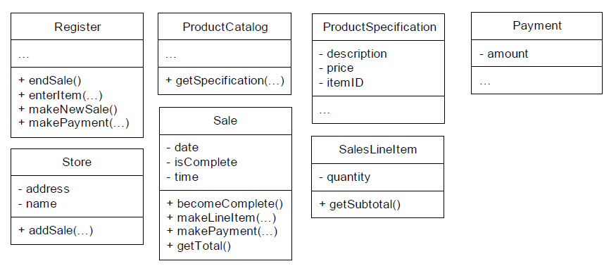
Method Names from Interaction Diagrams

Slide 13
Add More Type Information
The types of the attributes, method parameters, and method return values may all optionally be shown.
The question as to whether to show this information or not should be considered in the following context:
The DCD should be created by considering the audience.
If it is being created in a CASE tool with automatic code generation, full and exhaustive details are necessary.
If it is being created for software developers to read, exhaustive low-level detail may adversely affect the noise-to-value ratio.
Notes:
A CASE (Computer-Aided Software Engineering) tool with automatic code generation is software designed to assist in the software development process by automating certain tasks, including the generation of source code based on higher-level models, diagrams, or specifications. These tools aim to increase productivity, reduce errors, and standardize development practices.

Slide 14
Notation for Member Details
Sample Class
staticAttribute + publicAttribute - privateAttribute attributeWithVisibilityUnspecified attribute1 : type burgers : List of VeggieBurger attribute2 : type = initial value finalConstantAttribute : int = 5 { frozen } /derivedAttribute
classMethod() + «constructor» SampleClass(int) methodWithVisibilityUnspecified() methodReturnsSomething() : Foo abstractMethod() { abstract } + publicMethod() - privateMethod() # protectedMethod() ~ packageVisibleMethod() finalMethod() { leaf } synchronizedMethod() { guarded } method1WithParms(parm1:String, parm2:float) method2WithParms(parm1, parm2) method3WithParms(String, int) methodWithParmsAndReturn(parm1: String) : Foo methodWithParmsButUnspecified(...) : Foo methodWithParmsAndReturnBothUnspecified()
Notes:
A static attribute (also called a class attribute) is a variable or property that belongs to the class itself, rather than to any particular instance (object) of the class. This means that all instances of the class share the same static attribute, and any changes to it will be reflected across all instances.
This specifies that the attribute burgers is a collection (specifically, a List) that holds objects of type VeggieBurger. Example: burgers : List<VeggieBurger> (indicating a list of VeggieBurger objects).
The { frozen } notation indicates the attribute is immutable, meaning it cannot be changed after initialization.Example: finalConstantAttribute : int = 5 { frozen } (a constant integer attribute initialized to 5).
An abstract method, which means the method doesn't have an implementation in the class and must be implemented by a subclass.
A final method, meaning the method cannot be overridden in any subclass.
A synchronized method, meaning the method is thread-safe and ensures that only one thread can execute it at a time.

Slide 15
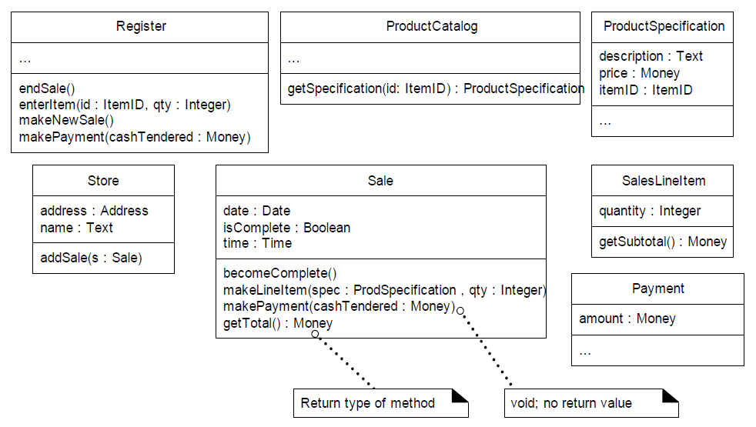
Add More Type Information

Slide 16
Adding Associations and Navigability
Each end of an association is called a role, and in the DCDs the role may be decorated with a navigability arrow.
Navigability is a property of the role that indicates that it is possible to navigate uni-directionally across the association from objects of the source to target class.
Navigability implies visibility—usually attribute visibility.

Slide 17
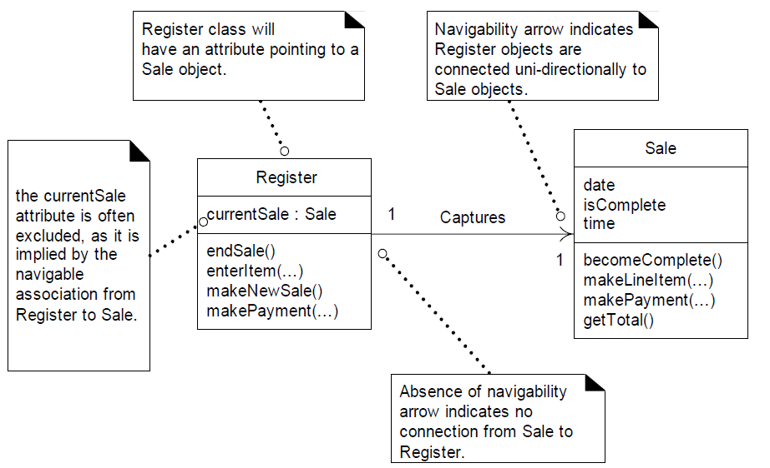
Adding Associations and Navigability
Notes:
If there’s an arrow from Register to Sale, it means that a Register object can "see" or access a Sale object, but not the other way around. So, the Register can point to a sale, but the Sale doesn’t need to point back to the Register. If there’s no arrow pointing back from Sale to Register, it means Sale objects don’t have any direct connection or access to the Register. The connection only works in one direction, from Register to Sale.

Slide 18
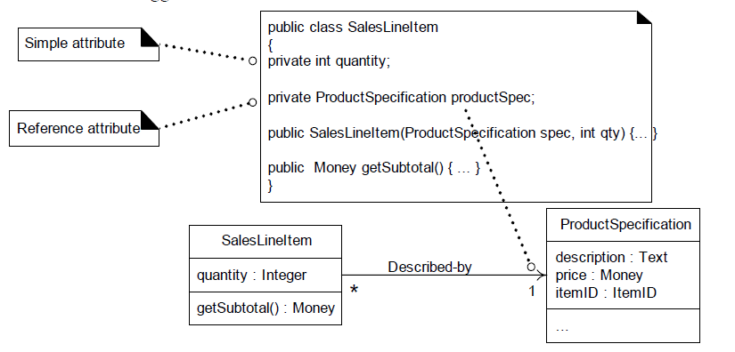
Adding Reference Attributes
Notes:
A SalesLineItem has an association to a ProductSpecification, with navigability to it. It is common to interpret this as a reference attribute in class SalesLineItem that refers to a ProductSpecification instance

Slide 19
Adding Associations and Navigability
The usual interpretation of an association with a navigability arrow is attribute visibility from the source to target class.
During implementation in an object-oriented programming language, it is usually translated as the source class having an attribute that refers to an instance of the target class.
For instance, the Register class will define an attribute that references a Sale instance.
Most, if not all, associations in DCDs should be adorned with the necessary navigability arrows.

Slide 20
Adding Associations and Navigability
Identify:
1 to many relationships
If it is a superior/subordinate relationship, add visibility from superior to subordinate
Ex. From Sale to SaleItem
For Mandatory associations where one can’t live without the other
Add navigation from independent to dependent:
Ex. From Customer to Sale

Slide 21
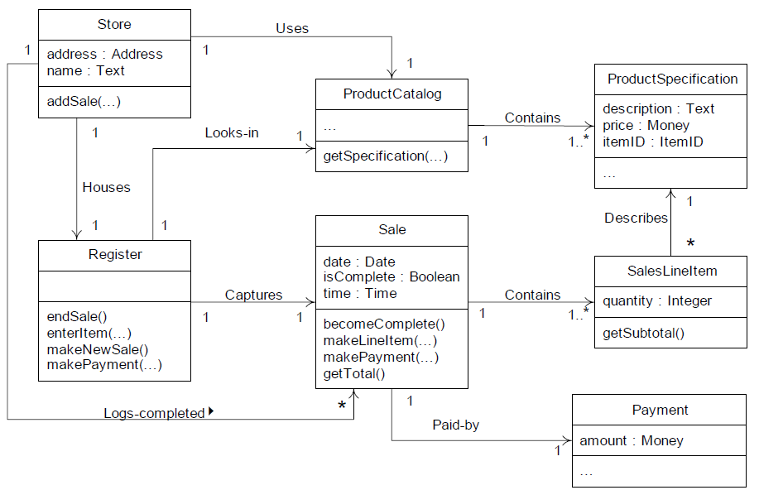
DCD for NextGen POS

Slide 22
Enumeration Class
An enum class (or enumeration class) is a special type of class in object-oriented programming that defines a group of named constant values.
Enum class allows you to define your own type that can only have certain values, like a list of options.
<<enumeration>> EnumerationName
Value1 Value2 Value3

Slide 23
Enumeration Class
An enum class (or enumeration class) is a special type of class in object-oriented programming that defines a group of named constant values.
Enum class allows you to define your own type that can only have certain values, like a list of options.
<<enumeration>> TaskStatus
Pending InProgress Completed
<<enumeration>> Day
Monday = 1 Tuesday = 2 Wednesday = 3 Thursday = 4 Friday = 5 Saturday = 6 Sunday = 7

Slide 24
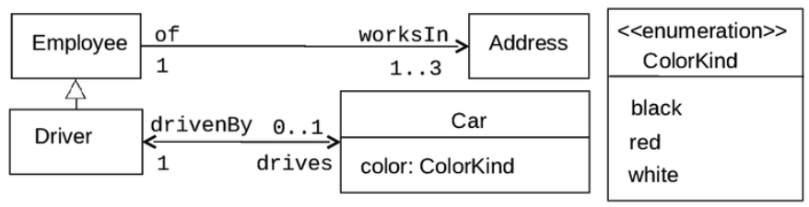
Enumeration Class
An enum class (or enumeration class) is a special type of class in object-oriented programming that defines a group of named constant values.
Enum class allows you to define your own type that can only have certain values, like a list of options.

Slide 25
References
Satzinger, John W., Robert B. Jackson, and Stephen D. Burd. Systems analysis and design in a changing world. 4th Edition.
Larman, Craig. Applying UML and patterns: an introduction to object oriented analysis and design and interative development. Pearson Education India, 2012.
Object-Oriented Modeling and Design with UML, Michael R. Blaha and James R. Rumbaugh, 2nd Edition, Pearson, 2005.

